Slide 1
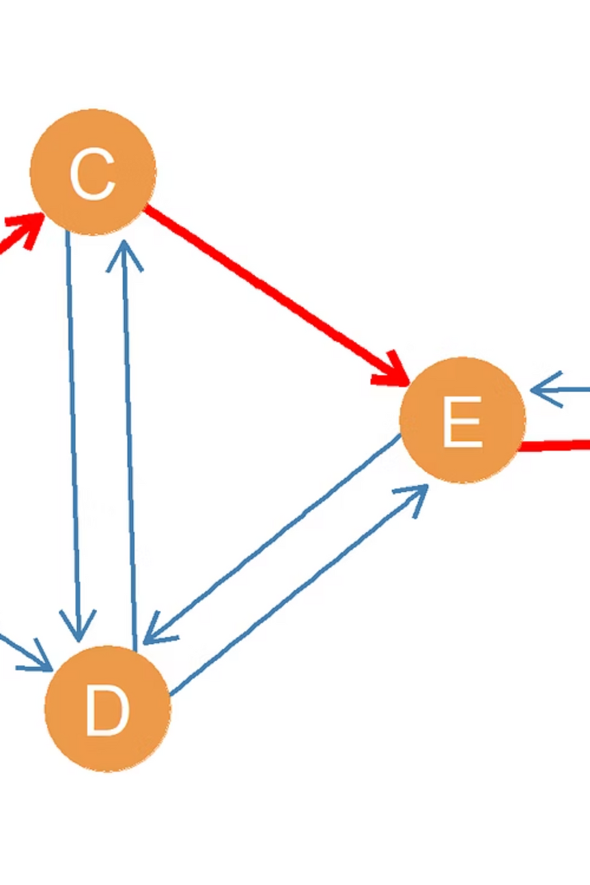

Mini Project on Directed Graph Using Adjacency Matrix
Course: CSE 106 – Discrete Mathematics Mini Project 1 (Odd Group)
Team Name: AlgoAvengers
Team Members:
  Arup Bhowmik Pritom (2025-2-60-330)
  Mahin Mahjabin (2025-2-60-385)
  Lakibul Hasan (2025-2-60-294)
Department of Computer Science & Engineering
Notes:
1

Slide 2
Objective of the Mini Project
To randomly generate a directed graph using C programming
To represent the graph using an adjacency matrix
To compute the in-degree and out-degree of all vertices
To verify that the sum of in-degrees equals the sum of out-degrees
To analyze the computational time complexity of the program
Notes:
2

Slide 3
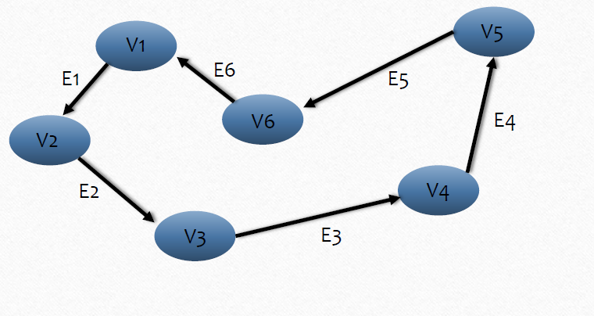
Directed Graph and Adjacency Matrix
Directed Graph
Adjacency Matrix Representation:
  A directed graph consists of vertices and directed edges
  A 2D matrix of size n × n
  Each edge has a specific direction
  matrix[i][j] = 1 if there is an edge from vertex i to vertex j
  matrix[i][j] = 0 otherwise
Notes:
3

Slide 4
Methodology
The program follows these steps:
01
02
Take the number of vertices n as input
Generate a random n × n adjacency matrix
03
04
Calculate in-degrees by summing each column
Calculate out-degrees by summing each row
05
06
Measure execution time using the clock() function
Repeat the process for different values of n
Notes:
4

Slide 5
In-degree and Out-degree (Basic Property of Directed Graph)
Out-degree of a vertex:
In-degree of a vertex:
Number of outgoing edges
Number of incoming edges
Calculated by summing the elements of a row
Calculated by summing the elements of a column
Property: Sum of in-degrees = Sum of out-degrees
Notes:
5

Slide 6
Experimental Setup
We executed the program for different input sizes:
n = 1000
n = 2000
n = 3000
n = 4000
n = 5000
For each value of n:
  We measured time execution.
  We measured Printing time.
  We recorded the results.
Notes:
6

Slide 7
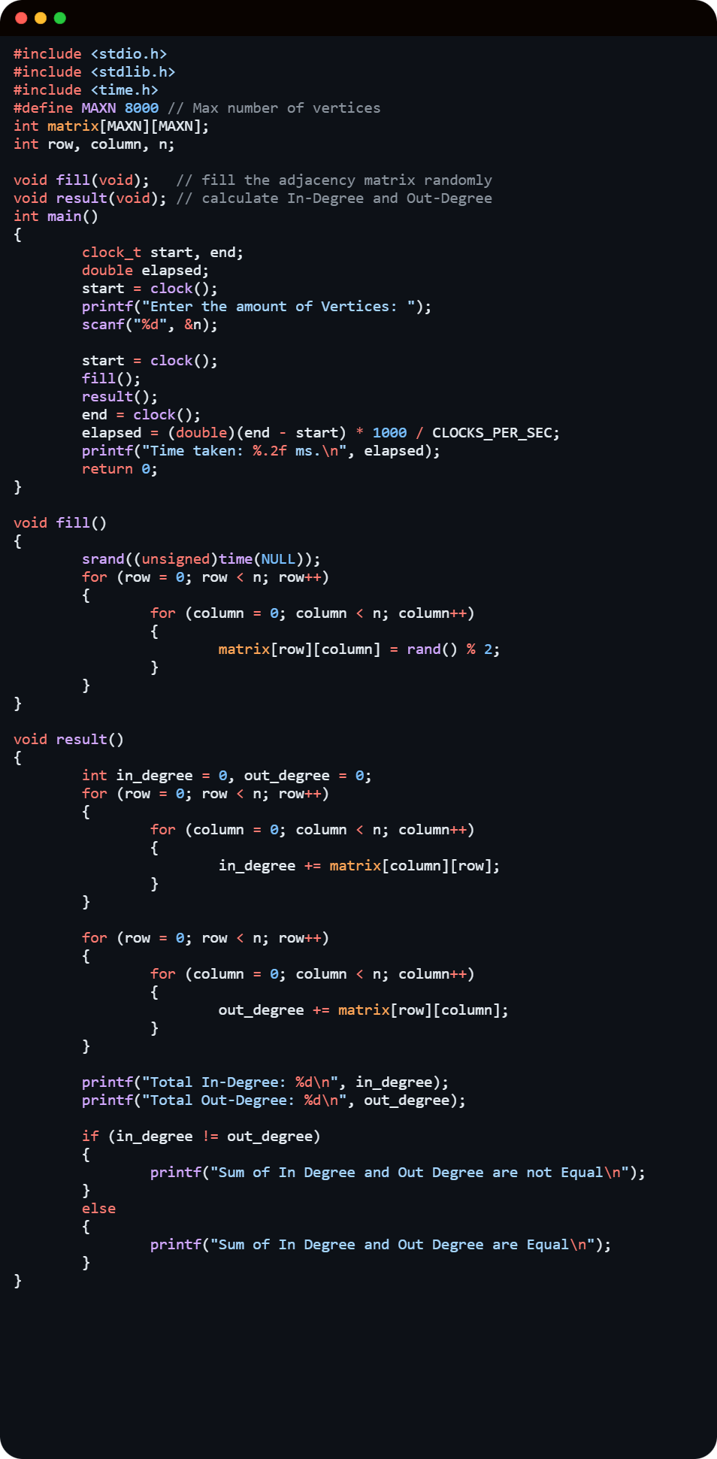
Code
Notes:
6

Slide 8
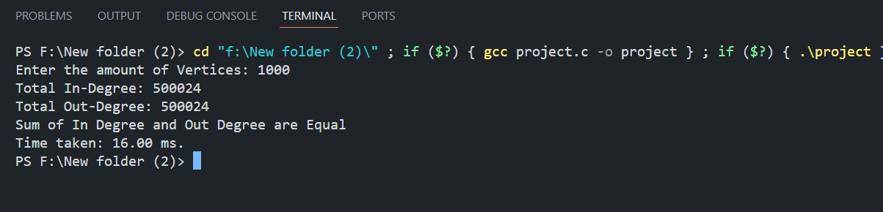
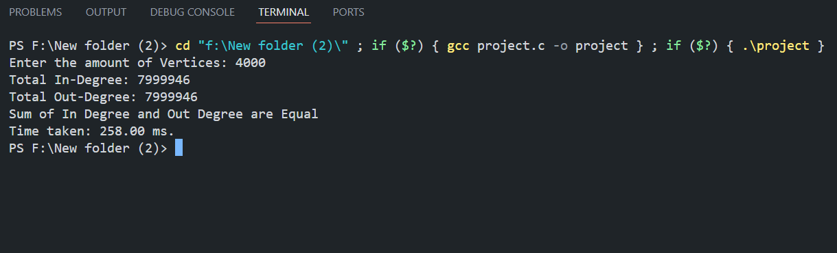
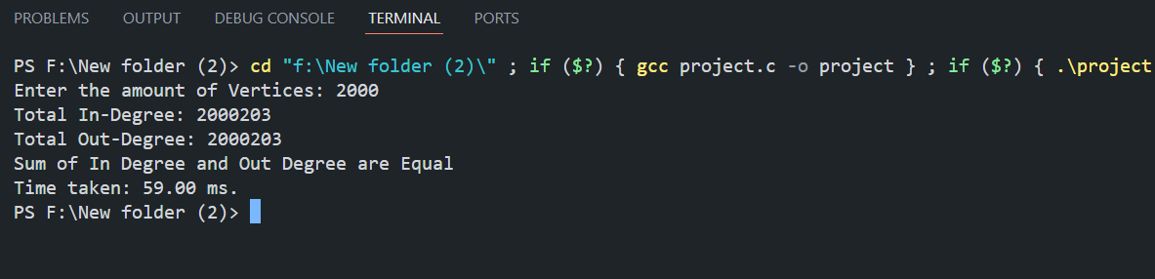
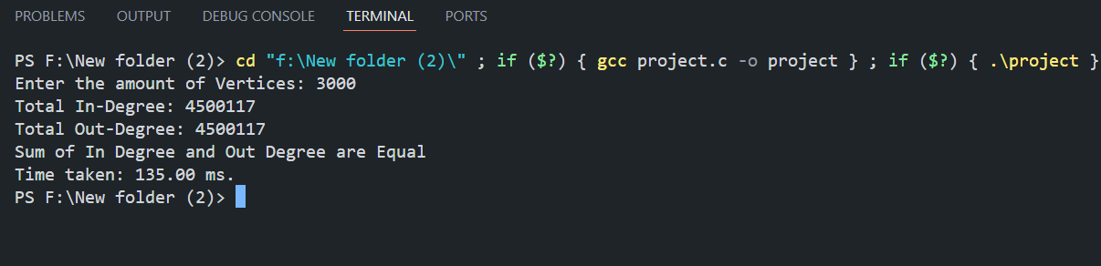
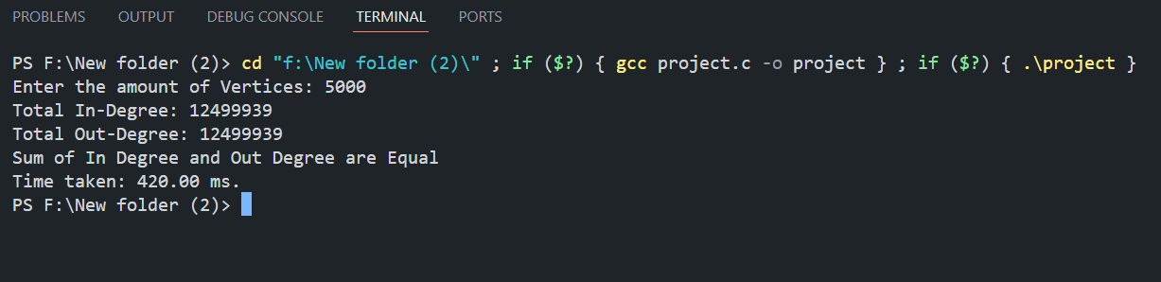
Output
Notes:
6

Slide 9
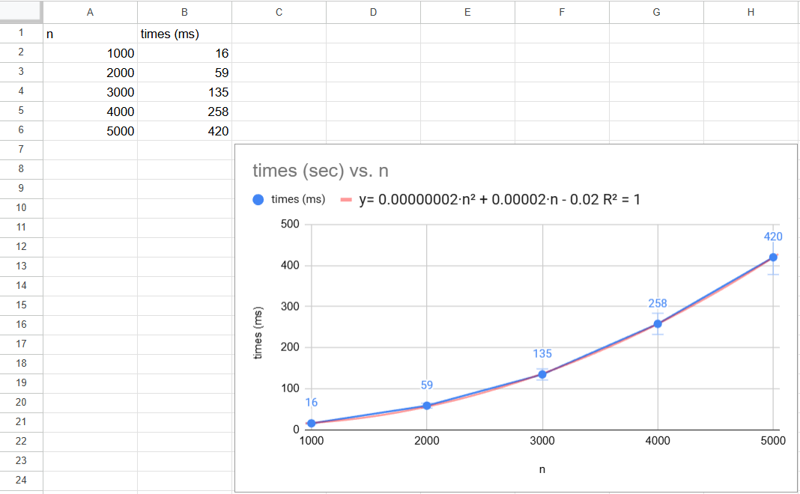
Execution Time vs Number of Vertices
  We Plotted line graph using Google Sheets
  X-axis represents number of vertices (n)
  Y-axis represents execution time (seconds)
  A polynomial trendline was added
  Trendline equation and R² value were displayed
Notes:
7

Slide 10
Theoretical Time Complexity: O(n²)
To calculate all in-degrees and out-degrees, we scan the entire n X n adjacency matrix once. Therefore, the total number of operations is proportional to n^2, making the complexity O(n^2).
Total operations = O(n)× O(n) = O(n^2)
Total time complexity = O(n^2) + O(n^2) = O(n^2)
Notes:
8

Slide 11
Experimental time complexity ( from graph ) :
The equation of the trendline was of the form :
y = 0.00000002n2 + 0.00002n − 0.02
The highest degree term in the equation is n^2 which confirms that the time complexity grows quadratically with n.
The trendline shows a quadratic relationship between the computational time and n
The experimental results also suggest that the complexity of the program is O(n^ 2).
Comparison Theoretical vs Experimental
From analyzing the code, we determined that the time complexity is O(n^ 2).
From the excel graph and the polynomial trendline, confirming that the experimental time complexity also O(n^ 2)
Both the theoretical and experimental time complexity of the program are O(n^ 2).
Experimental and theoretical results match.
Notes:
8

Slide 12
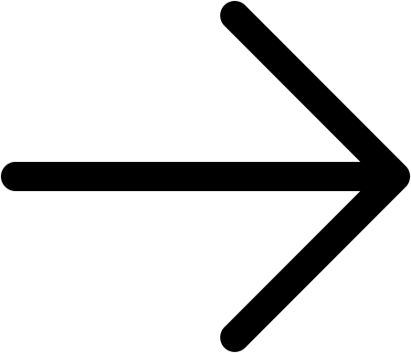
Conclusion
Directed graph generation was successfully implemented
In-degree and out-degree were correctly computed
The property sum(in-degree) = sum(out-degree) was verified
Execution time analysis shows O(n²) complexity
Our project demonstrates graph representation and algorithm efficiency.
Notes:
9

Slide 13
Thank You
Notes:
10

